Slide 1
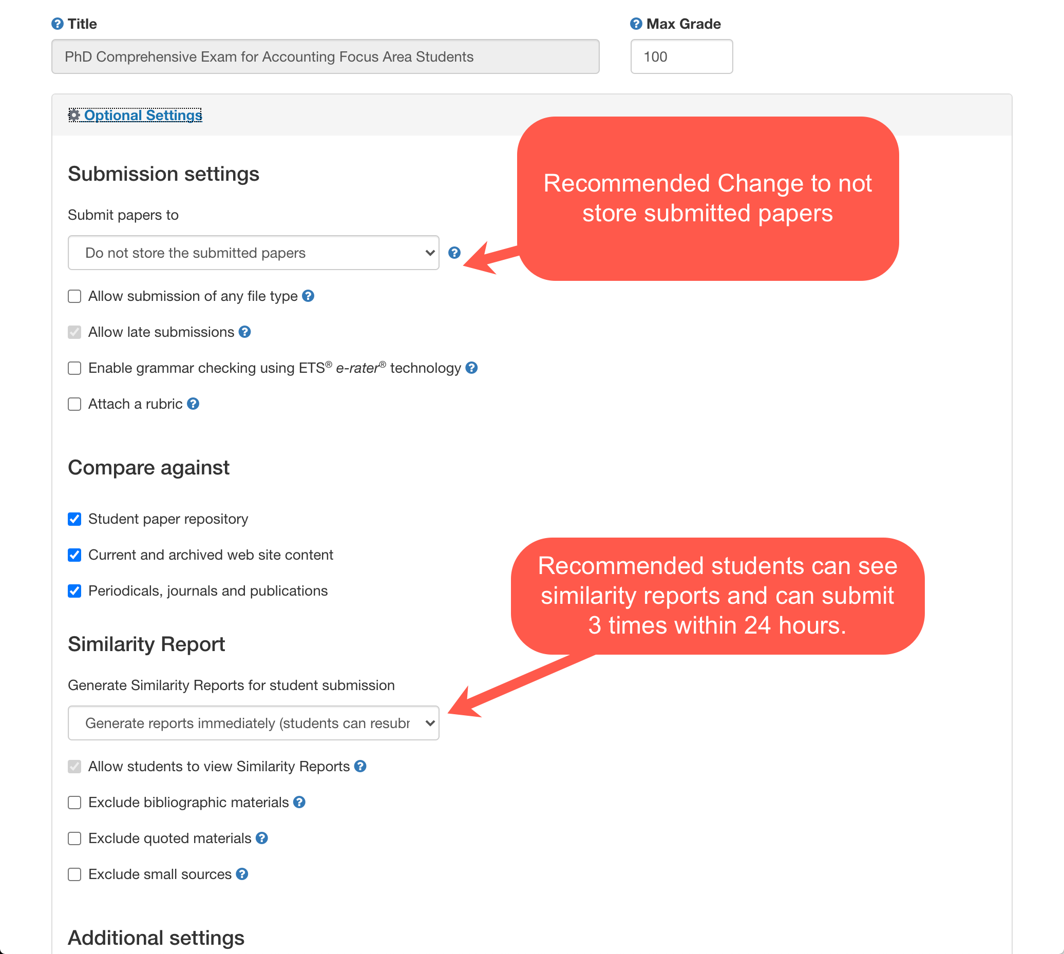
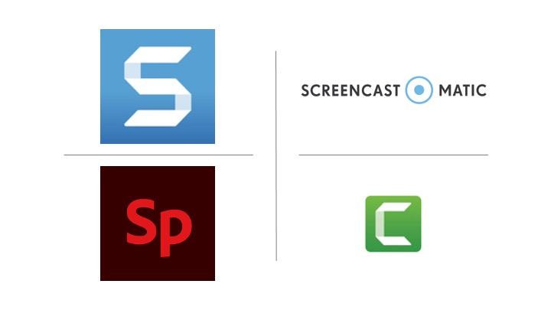
Timesavers: Audio and Video Feedback Veronica Paz, Timothy Creel, and Christine Olear Indiana University of Pennsylvania, Lipscomb University, and Penn State University-Brandywine
www.drvpaz.com
ORCID QR Code
Introduction
Methodology
Examples
Feedback especially for projects or written assignments are especially time consuming for professors. The authors provide ways in which to speed up this process by using audio and video feedback. The authors provide software tools to use such as Screen-cast-omic, Snagit, or Camtasia to provide this feedback. The authors provide their methodology and student reactions.
The authors use several software tools to record their video and audio feedback.
Learning Management System Tools
The simplest is that in the Learning Management System (LMS), whether it’s Canvas or Brightspace each has an audio feature limited to 60 seconds or a video feedback option limited to three minutes.
Video Software Tools: Screen Cast O Matic and Camtasia
The authors also use Screen-Cast-o-Matic to give feedback and then share that personalized link with the student. Camtasia is another video creation software similar to Screen-Cast-o Matic that can be used in much the same way.
Snagit
The authors also use SnagIt to take images of submissions and add instructions.
Adobe Spark
Adobe Spark allows the instructor to record a video and insert images to provide a quick overview of an assignment or detailed feedback.
Screen Cast o Matic
Forensic Accounting Milestone Feedback
https://drvpaz.screencasthost.com/watch/crhqICVfGp4
Snag It Example
Adobe Spark
An example from a PhD class for a journal review.
https://spark.adobe.com/video/nWIJofAjhy8lo

