Slide 1
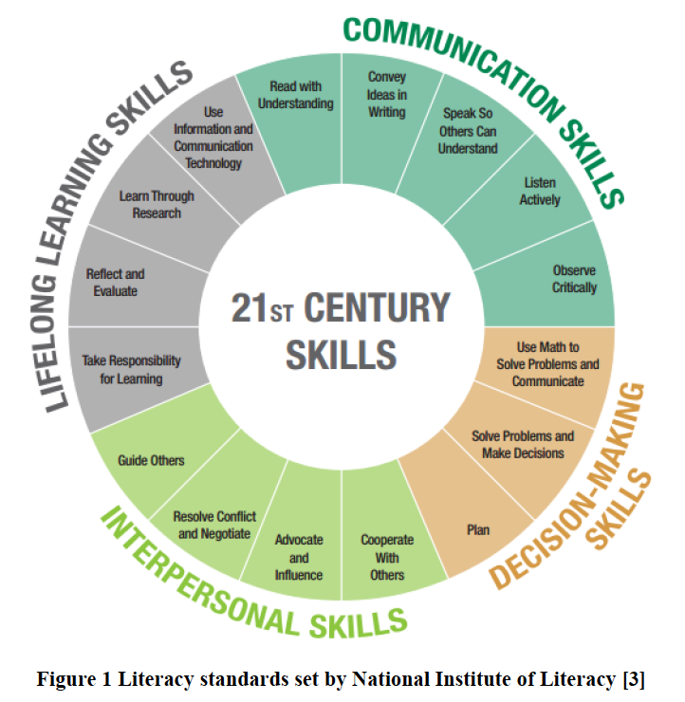
Providing Accounting Students with 21st Century Skills
Veronica Paz Professor of Accounting
Indiana University of Pennsylvania
Samantha Dzielski Accounting
Indiana University of Pennsylvania
ORCID QR Code
ORCID QR Code
Background
Skills Categories
Students need 21st century skills to be good accountants. Employers are not happy with accounting students who come out of college with weak written and oral communication, and poor decision-making skills. In higher education, we need to provide classes in a format that helps students develop each of these competencies. This paper provides methodologies used in teaching to help facilitate and teach students the tools they need to succeed in business.
The National Institute of Literacy has created a set of literacy standards called “Equipped for the Future (EFF) Content Standards: What Adults Need to Know and Be Able to Do in the 21st Century” (Gunasekaran, 2017). Based on the skill set shown in Figure 1 below, in academia, auditors and accountants are trained only to “Use math to solve problems and communicate” (Gunasekaran, 2017, p.3), while little effort is made to increase other skillsets. All the elements are important, but it may not be feasible to address all of them in an undergraduate accounting curriculum.
Communication Skills
Decision Making Skills
Interpersonal Skills
Lifelong Learning Skills
Read with understanding
Convey Ideas in Writing
Speak so others can understand
Listen Actively
Observe critically
Plan
Solve Problems and Make Decisions
Use Math to Solve Problems and Communicate
Guide Others
Resolve Conflict and Negotiate
Advocate and Influence
Cooperate with others
Take Responsibility for Learning
Reflect and Evaluate
Learn through Research
Use information and Communicate Technology
Assessments
21st Century Skills
Communication Skills
Decision Making Skills
Interpersonal Skills
Lifelong Learning Skills
Read with understanding
Pre-module Activities
Homework
Convey Ideas in Writing
Case Studies
Speak so others can understand
Class Discussions and Videos
Listen Actively
Class Discussions and Videos
Observe critically
Class Discussions and Videos
Plan
Solve Problems and Make Decisions.
Homework Assignments
Exams and Quizzes
Use Math to Solve Problems and Communicate
IDEA Data Analytics Project
Guide Others
Resolve Conflict and Negotiate
Advocate and Influence
Cooperate with others
All can be measured via group projects of IDEA data analytics and case studies.
Take Responsibility for Learning
Blended Format
Reflect and Evaluate
Learn through Research
IDEA Projects
Case Studies
Use information and Communicate Technology
IDEA
LMS and Homework platforms.
References
Gunasekaran, S. (2017). Integrated Teaching Model in Graduate Aerospace Classes: A Trial With Compressible Flow Aerodynamics. Proceedings of the ASEE Annual Conference & Exposition, 15031-15068. Retrieved from https://www.asee.org/public/conferences/78/papers/19310/view

